Slide 1
amp
2016-17

Slide 2
ART
ABOUT ME
23rd year teaching Art in Jeffco
9th year here at Rooney Ranch!!!
BFA in Painting and Drawing
My wife works for Jeffco and I have 2 daughters in Jeffco schools. 9th and 11th Grade

Slide 3
What we do in art?
Curriculum
Draw
Paint
Clay or sculpture
Weaving
Mixed media
Invent – explore – try new ideas and problem solve

Slide 4
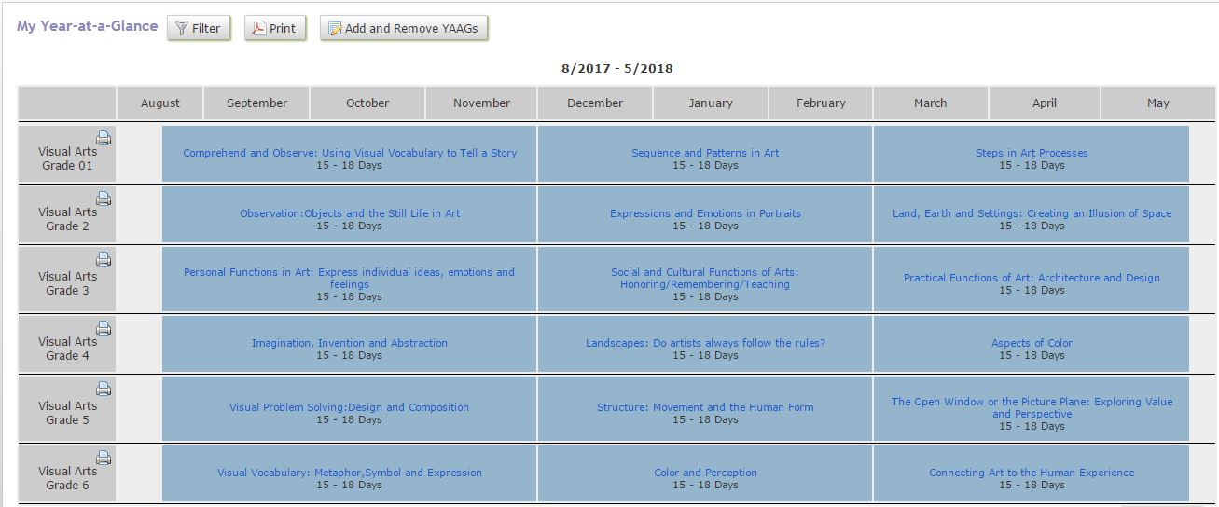

Slide 5
How I grade
Standards Grading
Participation + Effort = Success

Slide 6
Art – Standards grading Rubric
Self Portraits- 2nd Grade
 | 4 pts | 3 pts | 2 pts | 1 pts
Use of line and shape for features | 4 Portrait is VERY carefully drawn; ALL features (eyes, nose, mouth, eyebrows, hair, ears, neck and shoulders) drawn in correct proportion. Features placed correctly. Expression is evident in portrait. | 3 Portrait is carefully drawn, has all features (eyes, nose, mouth, eyebrows, hair, ears, neck and shoulders) in correct proportion. Features placed correctly. Expression evident in portrait. | 2 Portrait lacks some features (eyes, nose, mouth, eyebrows, hair, or ears), or features are drawn out of proportion. Neck and shoulders are not included or drawn sloppily. Cartoonish, expression is not evident. | 1 Much detail is missing. Features not easily recognizable or are ramdomly placed. Cartoonish, expression is not evident.
Use of space | 4 DRAWN WITH CARE. Space is allowed for a completed head and background. | 3 Student draws an appropriate closed shape to contain features and allows for a background. | 2 Head is too small (takes up less than half the paper). Shape is not enclosed and neck and shoulders are missing or not evident. | 1 Unfinished or unsatisfactory. Most of the features are unrecognizable.
Background | 4 Background is well-developed with relationship of parts to the whole. | 3 Background space is evident but not fully developed. More than one color, line and or shape used in background. | 2 Non-representational marks are visible in background. Solid one color background | 1 Unfinished or unsatisfactory.No background is evident.
Craftsmanship | 4 The materials are used VERY skillfully and shows excellent technique. | 3 Student uses the materials appropriately and shows good technique. | 2 Use of materials and technique is basic. | 1 Materials and technique incorrectly used.
Grading Policy:
Work is graded with a rubric based on the content standards for Visual Arts.

Slide 7
Music
ABOUT ME
6th year teaching music (coming to you from Rocky Mountain School of Expeditionary Learning)
1st year here at Rooney Ranch and I’m excited to be here!
BA in Music Education and Music Theory, Masters in Curriculum and Instruction

Slide 8
What We Do in Music
Learn About Musical Elements:
Timbre (all sounds) Expression (Mood, Style, Color +)
Tempo (Speed) Beat (Meter & Time Signature)
Rhythm Form
Melody Harmony
Listen, Evaluate, & Analyze Music
Develop Performance Skills

Slide 9
What We Do in Music – cont.
I teach using the Kodaly method, which means students will sequentially build upon their musical skills through singing and game play. In addition, our students will experience…
Playing Instruments
Reading Iconic & Traditional Notation
Composing, Improvising, & Arranging
Movement & Dance
Performing for Various Audiences
World Cultures
USA – Patriotic & Historical Folk Music

Slide 10
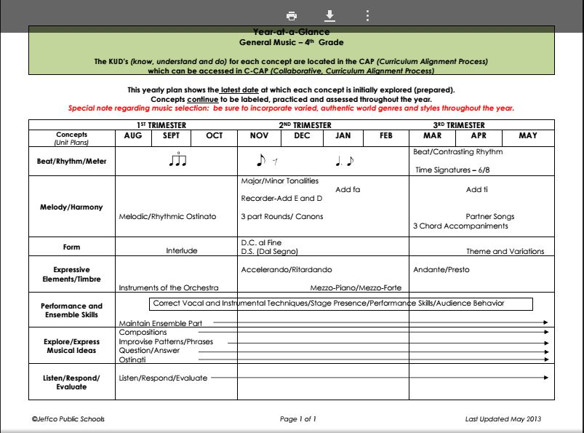

Slide 11
How I Grade
Participation + Effort = Success
EVERYONE is a musician! My primary goal is to teach kids to love making music.
Unsatisfactory grades are a reflection of in-class participation, not “natural talent.”

Slide 12
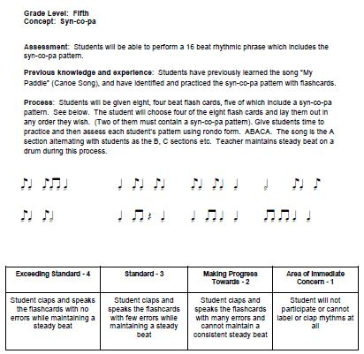
Standards Grading Rubric

Slide 13
Physical Education
ABOUT ME
Taught 3 years at Mount St. Vincent Home
20th year teaching PE in Jeffco
14th year here at Rooney Ranch!!!
Coaching Softball/Baseball 22yrs at D’Evelyn
Two Kids both in Jeffco Schools. Both attending D’Evelyn.

Slide 14
What we do In p.e.
Move
Play
Exercise
Interact
Games
Dance
Develop Skills
Improve Fitness
Interpersonal Skills
FUN

Slide 15
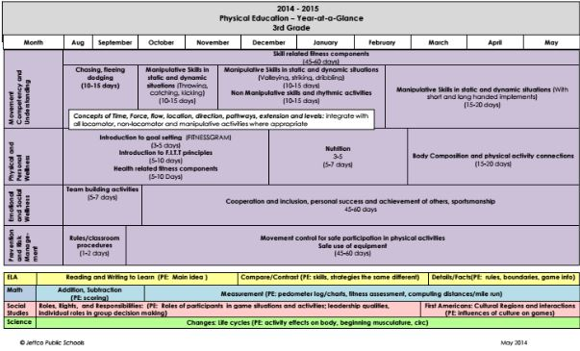

Slide 16
How I grade
Standards Grading
Participation + Effort = Success

Slide 17
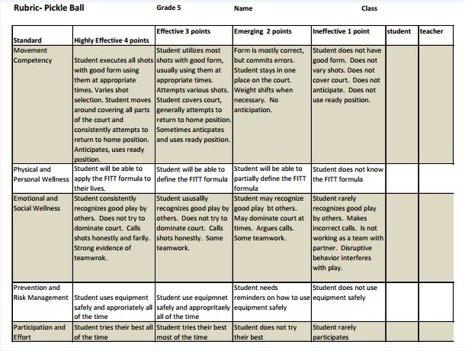

Slide 18
Tennis shoes
No tennis shoes = No participation
Please have proper tennis shoes.
No flip flops, slip ons, CROCS, hiking boots, ski boots, dress shoes, high heels, roller shoes.
Its all about keeping everyone safe!

Slide 19
SAMPLE Schedule

